Slide 1

Advanced Bitcoin Market Price Forecasting Using ML Techniques
Presented by:
S.Tejaswi (21MQ1A4226)
V.Dilip Datta Sai (21MQ1A4256)
Md.Neelofar (21MQ1A4220)
R.Kapil Harsha (21MQ1A4252)
HEAD OF THE DEPARTMENT: Dr . SYAM PRASAD,
B.Tech, M.Tech, PHD
Under the Guidance of:
M . Naresh Babu,
Assistant Professor

Slide 2
CONTENTS
ABSTRACT
EXISTING SYSTEM
PROPOSED SYSTEM
SOFTWARE REQUIREMENTS
HARDWARE REQUIREMENTS
ANALYSIS
UML DIAGRAMS
OUTPUT SCREENSHOTS
CONCLUSION
APPLICATIONS

Slide 3
ABSTRACT
Bitcoin's volatility poses major challenges for accurate forecasting. This project applies machine learning models— XGBoost, Logistic Regression, and Support Vector Machine (SVM) to predict Bitcoin price movements. Through structured data preprocessing, feature engineering, model training, and evaluation, the project aims to automate predictions, minimize human error, and assist investors with data-driven decision-making.

Slide 4
EXISTING SYSTEM
Models Used:
ARIMA (Autoregressive Integrated Moving Average): A time series model that forecasts prices based on the linear relationship between past and current data. Best suited for stable, short-term predictions but struggles with sudden price changes.
GARCH (Generalized Autoregressive Conditional Heteroskedasticity): A volatility forecasting model that analyzes variance in returns over time. Useful for capturing volatility clustering but limited in predicting actual price movements.
Disadvantages of Existing Systems:
Lack of Predictive Intelligence:
Heavy reliance on historical charts and manual analysis.
Limited Automation:
Forecasting often requires manual interpretation, causing delays.
No Real-Time Adaptability:
Systems fail to adapt to sudden market events and news.

Slide 5
PRORPOSED SYSTEM
The proposed system integrates machine learning models— XGBoost, Logistic Regression, and SVM—for predictive analysis of Bitcoin prices. The process includes automated data preprocessing, feature extraction, model training, prediction generation, and visualization through a Django-based web interface.
Advantages of Proposed System:
Higher prediction accuracy through machine learning.
Reduced human bias via automation.
Real-time adaptability to market fluctuations.
User-friendly interface for non-technical users.
Scalable to other cryptocurrencies and financial assets.

Slide 6
Software Requirements
OS: Windows 10/11, Ubuntu 18.04+, or macOS.
Python 3.7+, Jupyter Notebook, Google Colab.
Libraries: Pandas, NumPy, Scikit-learn, XGBoost, Matplotlib, Seaborn.
Django framework for UI development.

Slide 7
Hardware Requirements
Processor: Intel Core i5/i7 (or equivalent AMD Ryzen)
RAM: Minimum 16GB (Preferred: 32GB for large datasets)
Storage: SSD (Minimum 256GB, Recommended: 512GB+)
GPU: NVIDIA RTX 2060 or higher for machine learning models.

Slide 8
ANALYSIS
Historical Bitcoin data was collected from sources like Coin Market Cap and Yahoo Finance. Data preprocessing involved handling missing values and feature scaling. Feature engineering included adding indicators like Moving Averages and RSI. Machine learning models were trained, and evaluation metrics like accuracy, precision, recall, F1-score, and RMSE were used. XG Boost achieved the best results, indicating its superiority for this task.

Slide 9
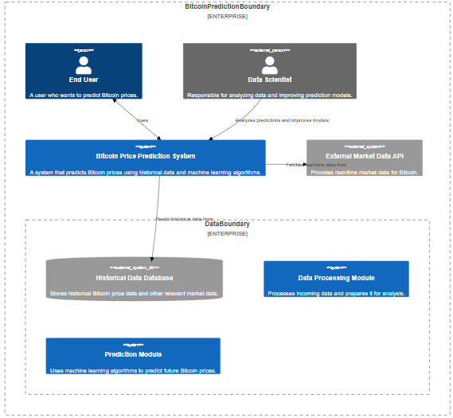
SYSTEM ARCHITECTURE DIAGRAM

Slide 10
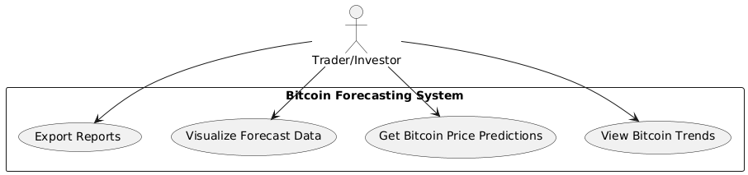
USE CASE DIAGRAM

Slide 11
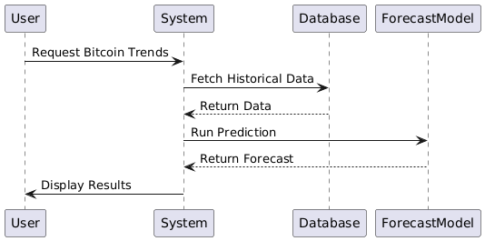
SEQUENCE DIAGRAM

Slide 12
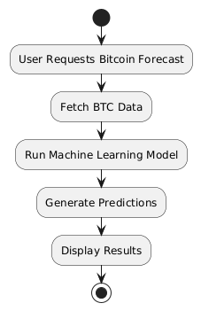
ACTIVITY DIAGRAM

Slide 13
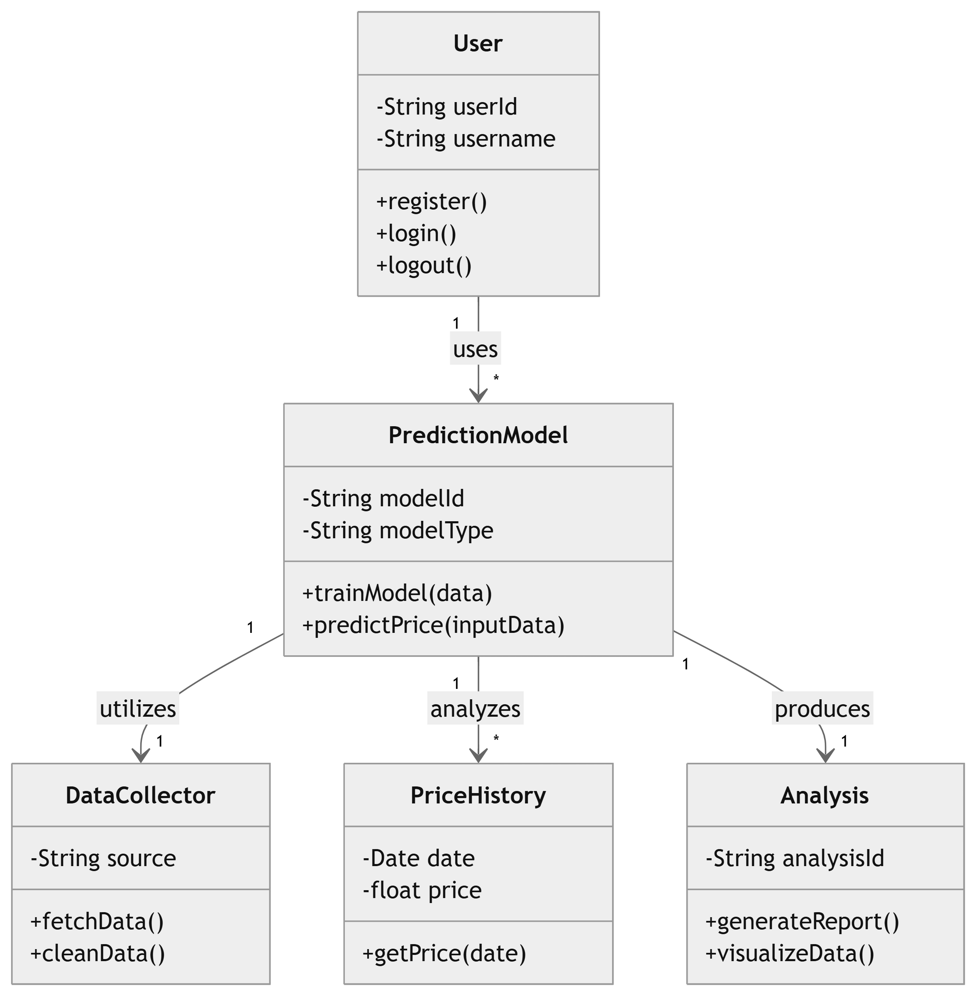
CLASS DIAGRAM

Slide 14
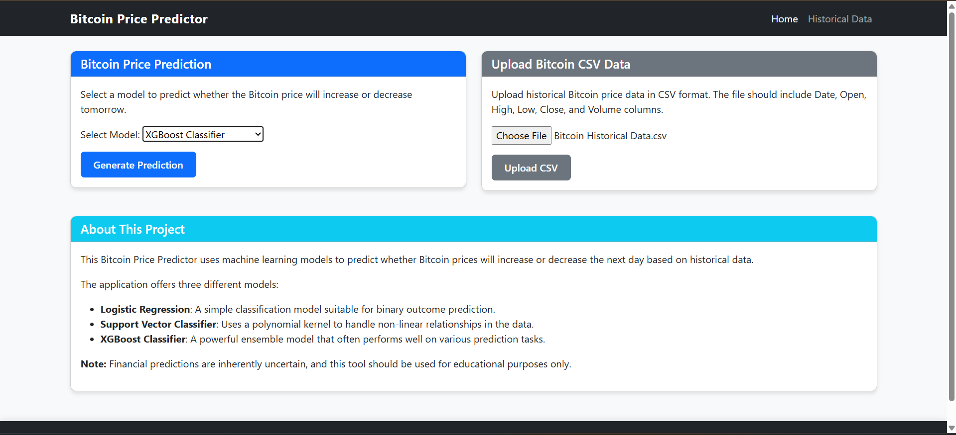
OUTPUT SCREENSHOTS
Fig 1: Home page of BITCOIN PRICE PREDICTION

Slide 15
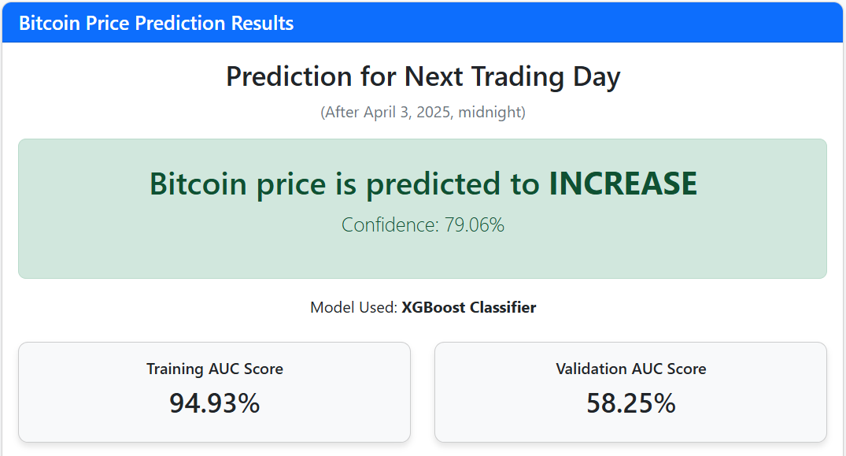
Fig 2:Bitcoin Price Prediction Results for the next Trading Day

Slide 16
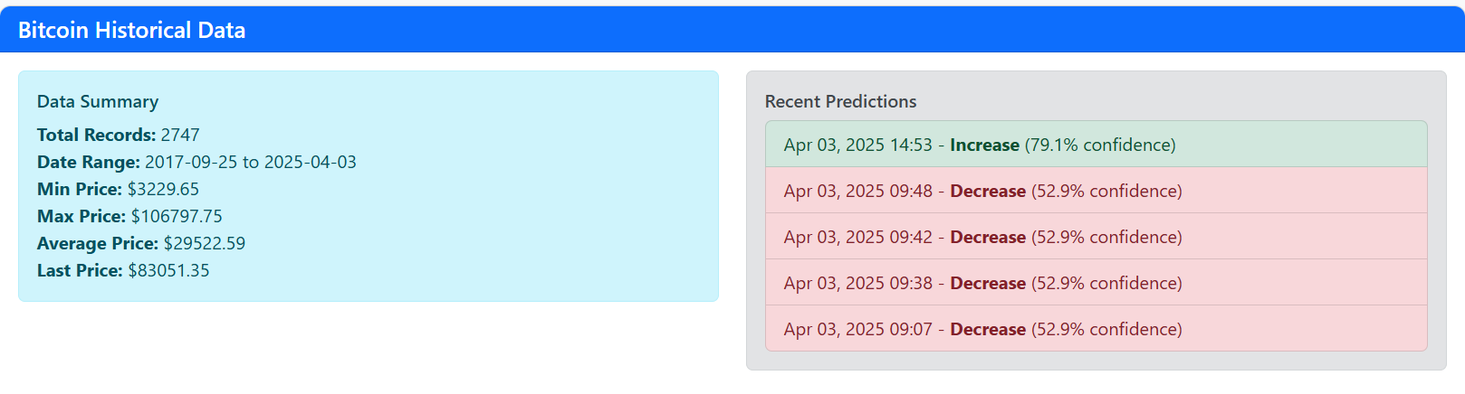
Fig 3: Bitcoin Historical Data

Slide 17
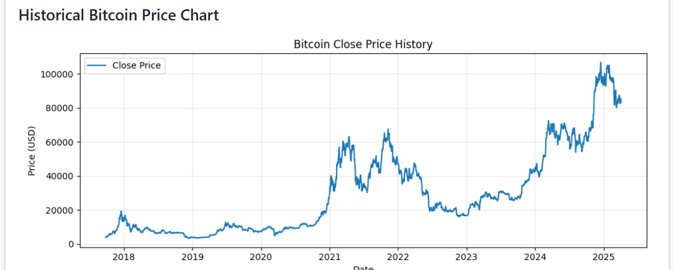
Fig 4: Historical Bitcoin Price Chart( Date vs Price(USD) )

Slide 18
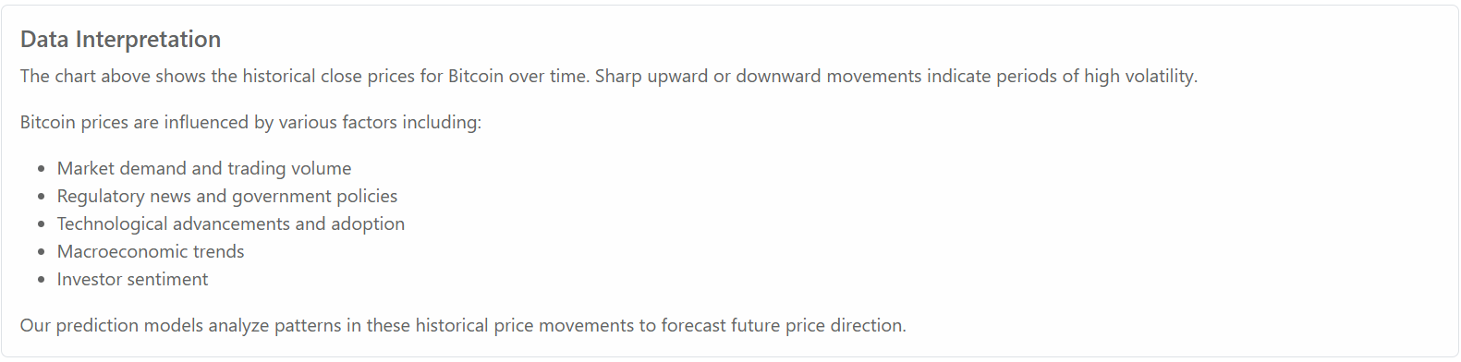
Fig 5:Factors Influencing Bitcoin Prices

Slide 19
Key Features
1.Data Fetching: Fetches historical BTC-USD price data from Yahoo Finance.
2.Technical Indicators: Calculates 12 technical indicators such as SMA, EMA, MACD, RSI, and more.
3.Signal Generation: Determines trading signals (long/short/neutral) based on the change in closing price.
4.Machine Learning: Uses XGBoost to predict trading signals based on feature importance.
5.Trading Strategy: Implements a simulated trading strategy, recording entry and exit points and evaluating overall return.
6.Visualization: Displays feature importance, balance over time, and BTC-USD close prices with trading points.

Slide 20
CONCLUSION
Machine learning significantly enhances the ability to predict Bitcoin price movements compared to manual methods. XGBoost emerged as the most effective model, followed by Logistic Regression and SVM. The Django interface enables user-friendly interactions. Future work includes integrating real-time data feeds, sentiment analysis from social media, and deploying deep learning models like LSTM for better sequential prediction capabilities. Machine learning-based forecasting systems represent a promising future for cryptocurrency market analysis.

Slide 21
APPLICATIONS
Cryptocurrency trading and investment decision support.
Financial market analysis for hedge funds and portfolio managers.
Risk management and portfolio optimization.
Blockchain and crypto exchange optimization.
Academic research and fintech innovations.

Slide 22


